Slide 1
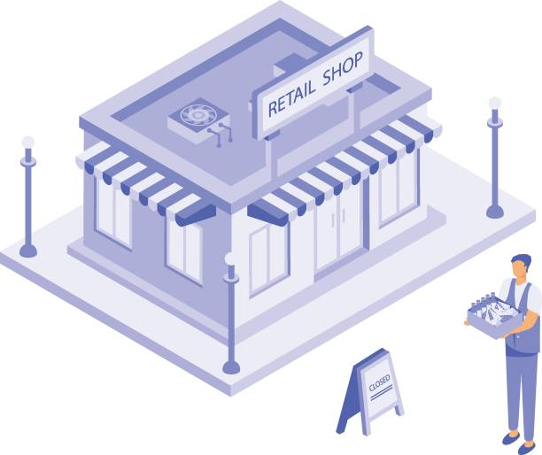
Retail Shop Analysis
Revenue Trends & Data Insights Nainesh Shewade | June 2025

Slide 2

Introduction
Objective: Analyze retail data to uncover revenue trends over time
Tools Used: Python, Pandas, Seaborn, Matplotlib

Slide 3

Dataset Overview
Source: retail_dataset_100k.csv
Data includes transaction details for a retail shop
Initial preview includes head(), tail(), shape, size, and columns

Slide 4

Data Preparation
Loaded dataset into a Pandas DataFrame
Verified structure with df.head(), df.tail()
Used df.shape and df.columns for data overview

Slide 5

Exploratory Data Analysis
Checked for missing values and duplicates
Analyzed column data types and distributions

Slide 6
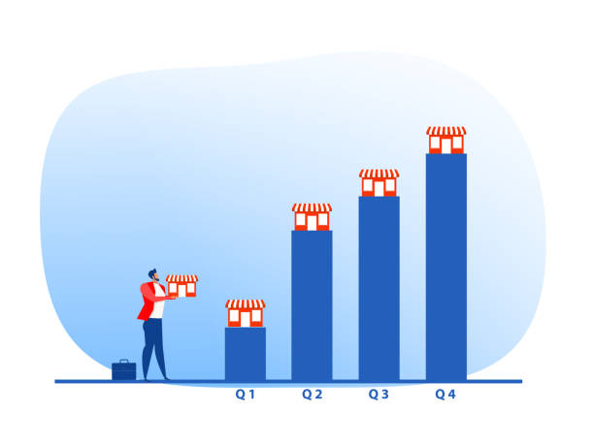
Revenue Over Time
Visualized revenue trends over time
Identified seasonal patterns and peak months

Slide 7
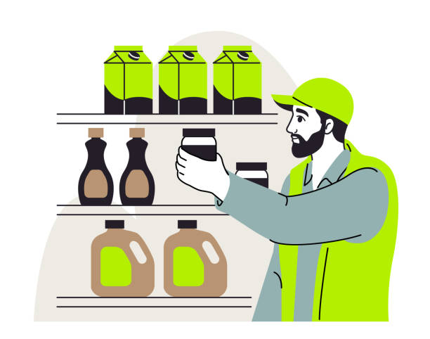
Top Performing Categories
Identified top-selling product categories
Visualized category-wise revenue contributions

Slide 8
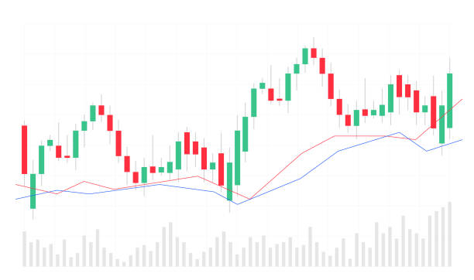
Customer or Regional Analysis
Analyzed sales trends by region or customer type
Observed regional patterns and preferences

Slide 9
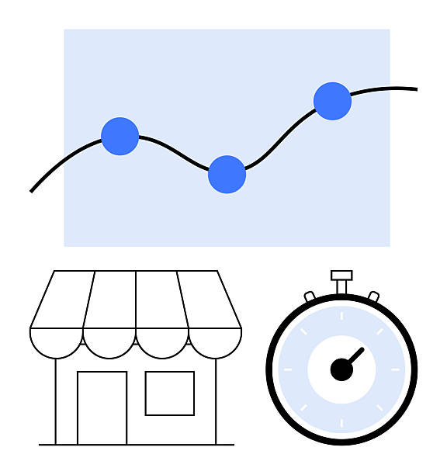
Key Insights
Seasonal demand affects revenue
Certain categories contribute disproportionately to revenue
Opportunity for targeted marketing

Slide 10

Conclusion & Recommendations
Leverage top-performing categories for promotions
Prepare inventory based on seasonal demand
Use customer segmentation for personalized marketing

Slide 11


